Slide 1

Small Radio Telescope
~Clayton Hanson

Slide 2

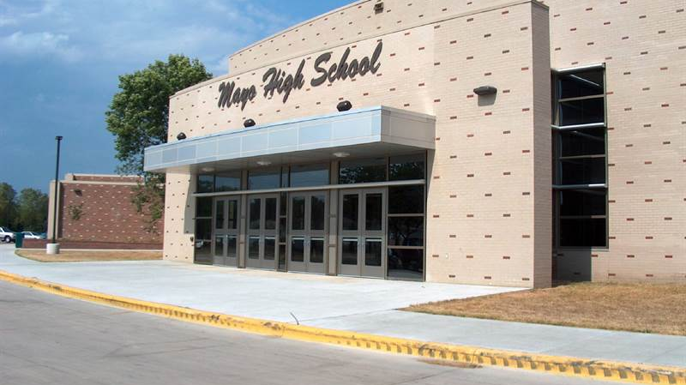

Slide 3

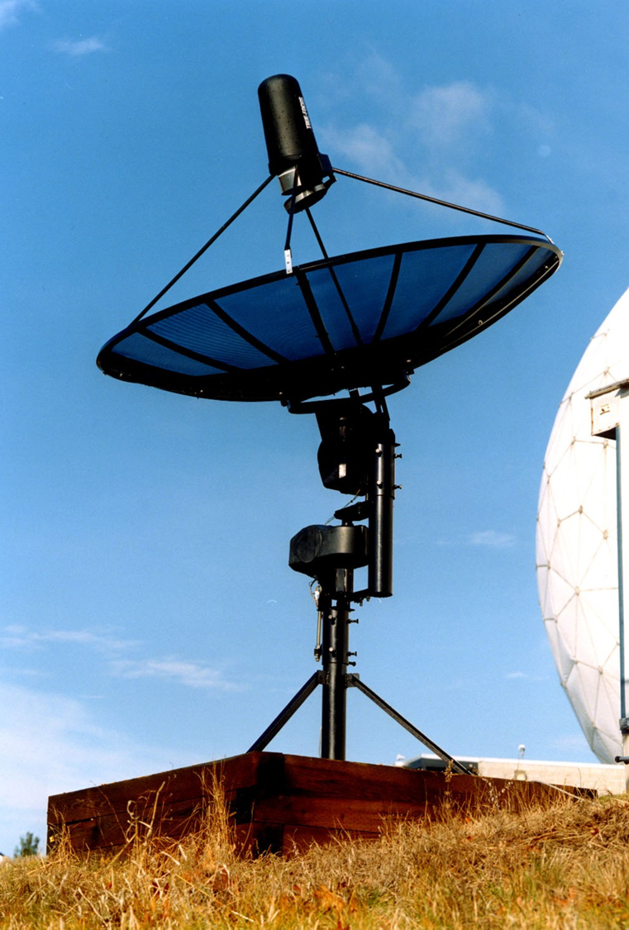
What we may have someday
A 2.3 meter dish with arms to hold a Software Defined Radio or various other observing devices.
Motors that control altitude and azimuth direction.
PC/PBT blended plastic enclosures
A 13 ft hexagonal base to support the mounting system.

Slide 4
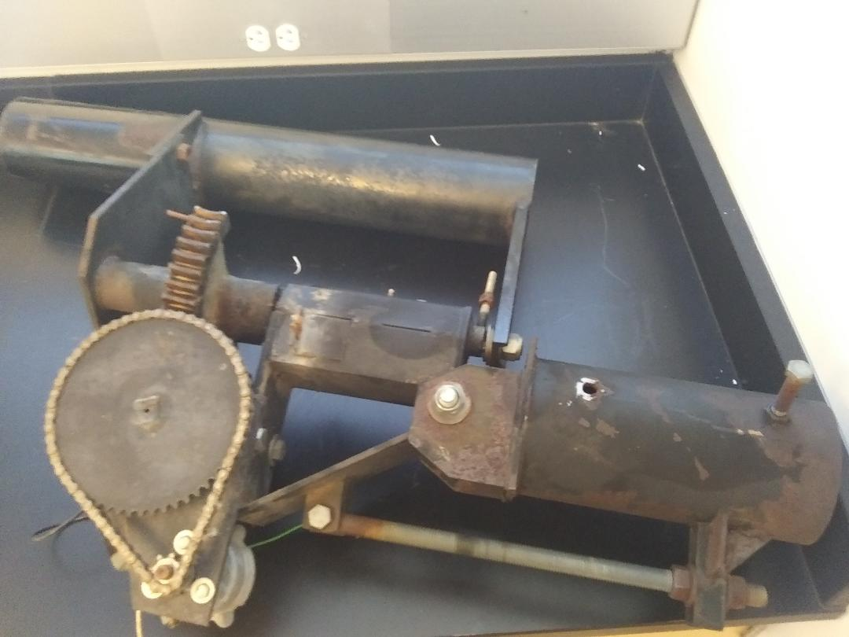
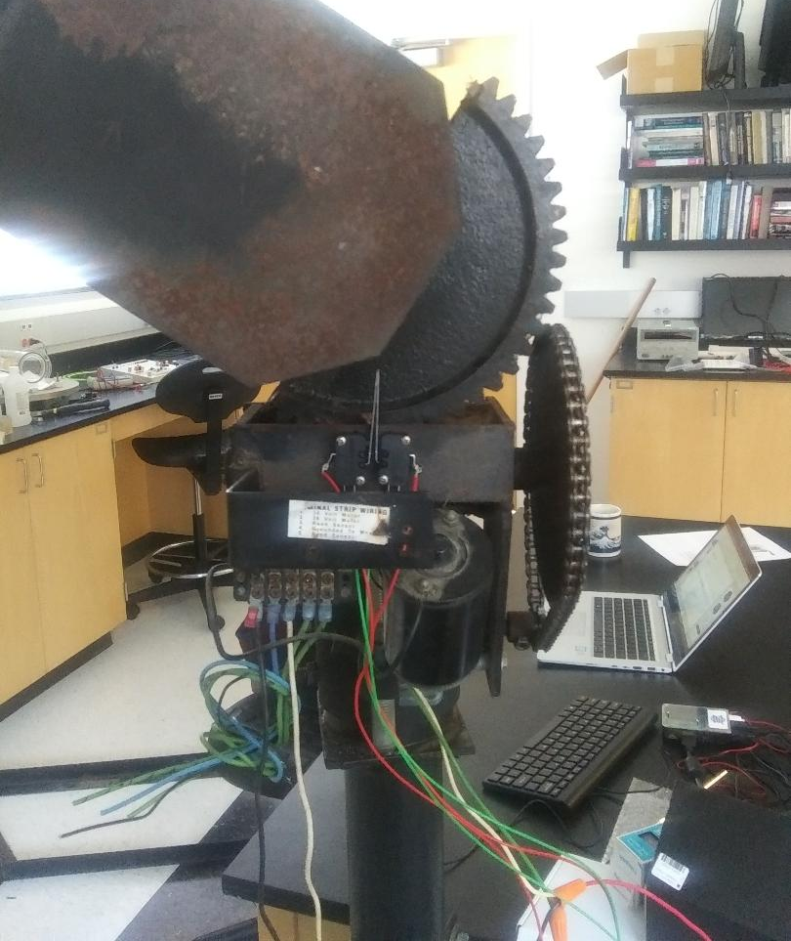
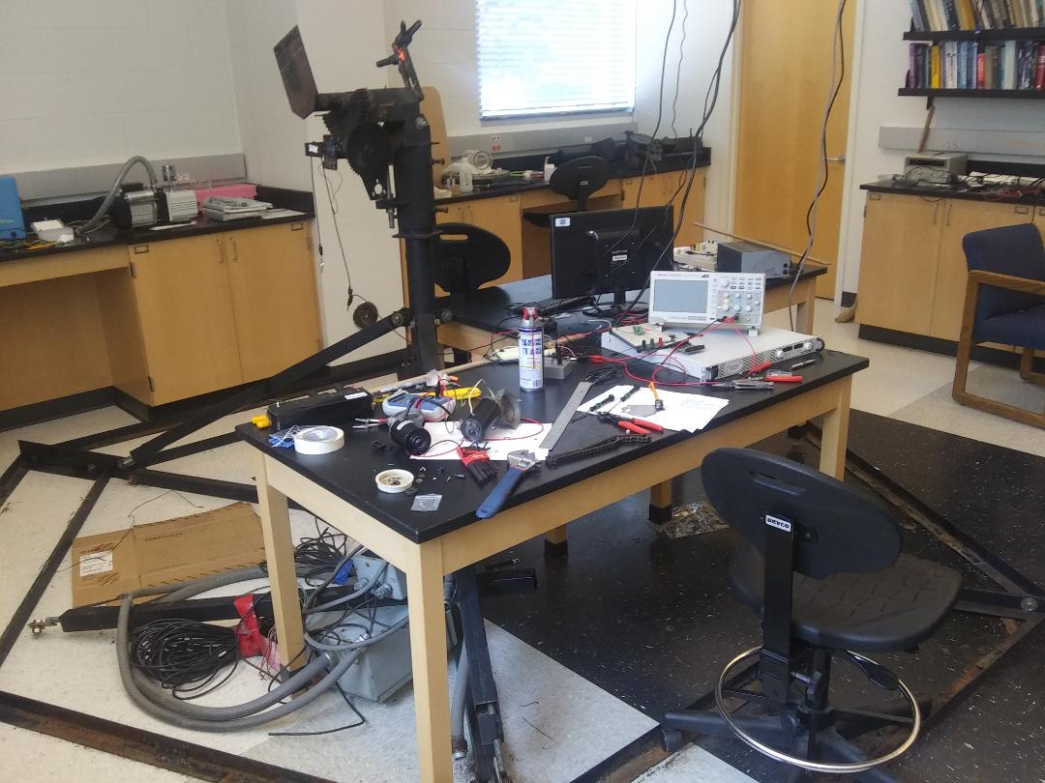
What we Have now

Slide 5
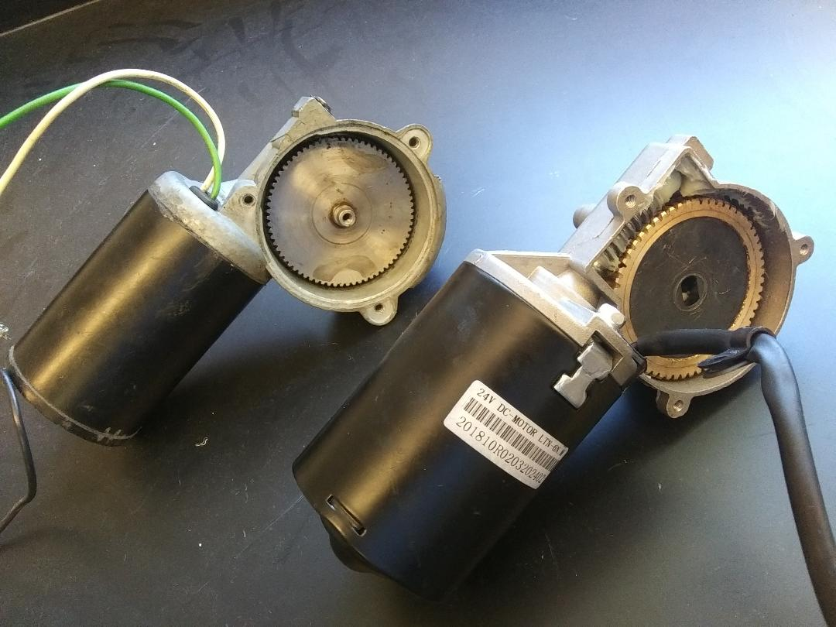
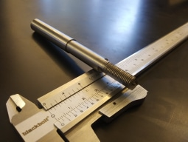
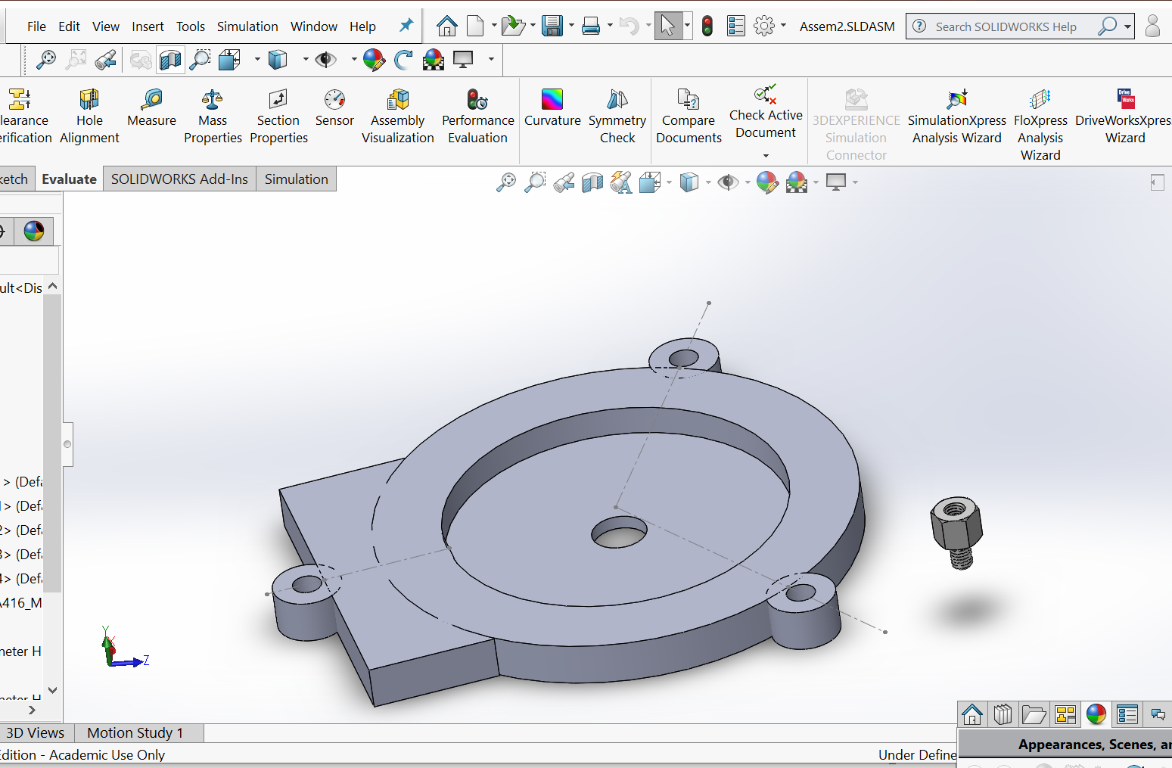
Motors and Gears
The motors the SRT came with were in need of replacement
Due to how old the SRT is the exact same motors were not found.
The new motors are metric while the rest of the system is primarily imperial.
New shafts are being machined as well as a new cover.

Slide 6
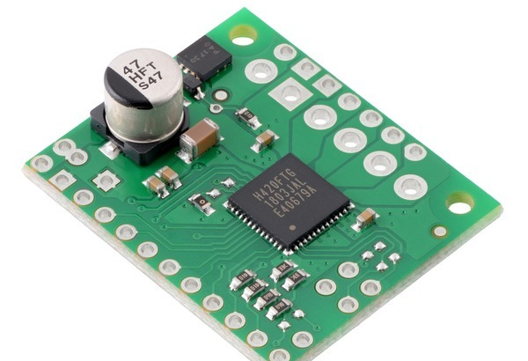
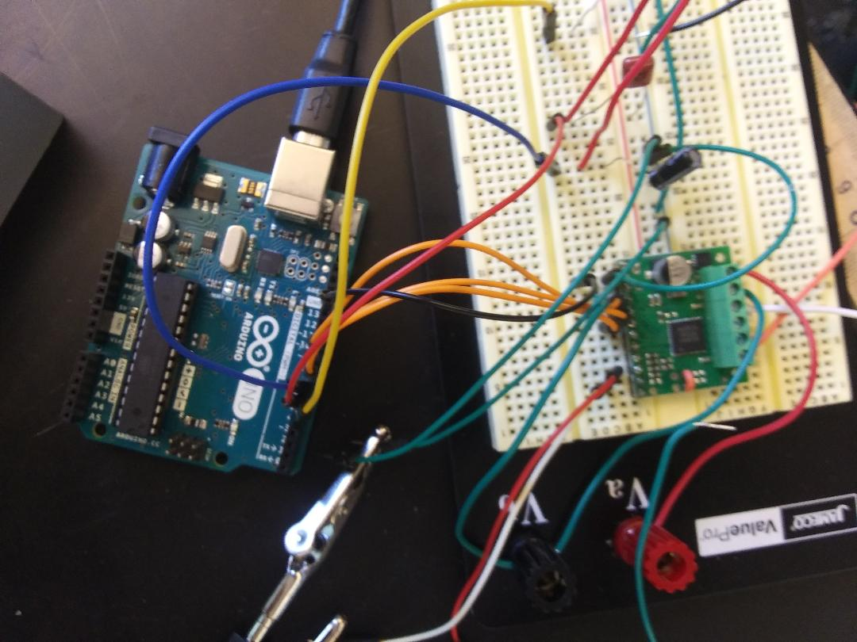
Pololu Motor Driver carrier
The Pololu chip allows for the direction of current to be adjusted for up to two motors.
Since the motors being used are higher current than the dual channel mode on the Pololu can handle, it features the option to use its dual H-bridge wiring in parallel for a single motor.
Additionally, the Pololu offers a PWM input pin which it will match on the output pins.
The Pololu also offers two channels that work in tangent to give an all clear or series of error messages.

Slide 7
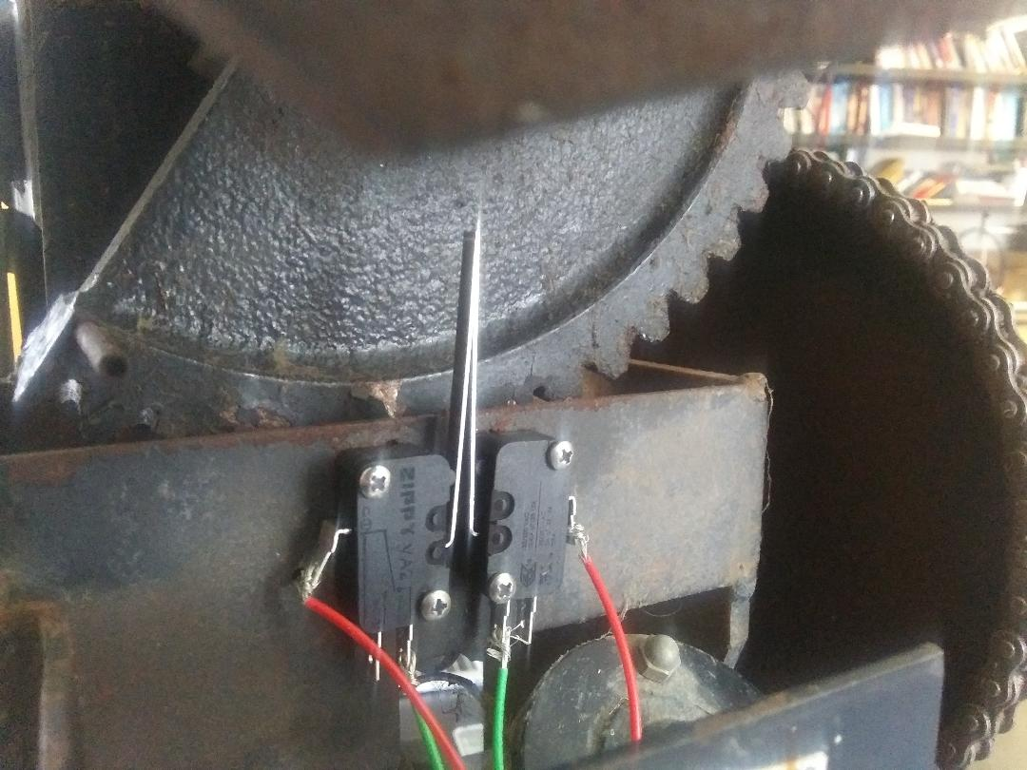
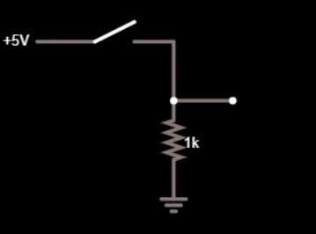

Limit Switches help not break things
The mounting gear only allows for 180° of motion.
Two limiting switches allow for the limits to be sensed and power turned off to the motor.
This is also how the position of the motors will be determined upon starting up the equipment.

Slide 8
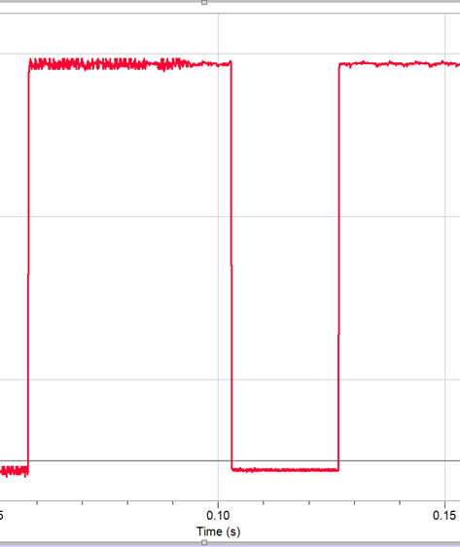
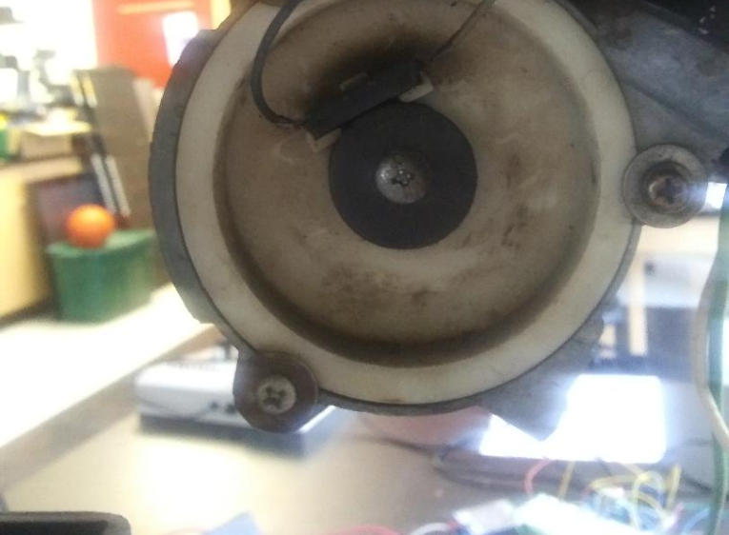
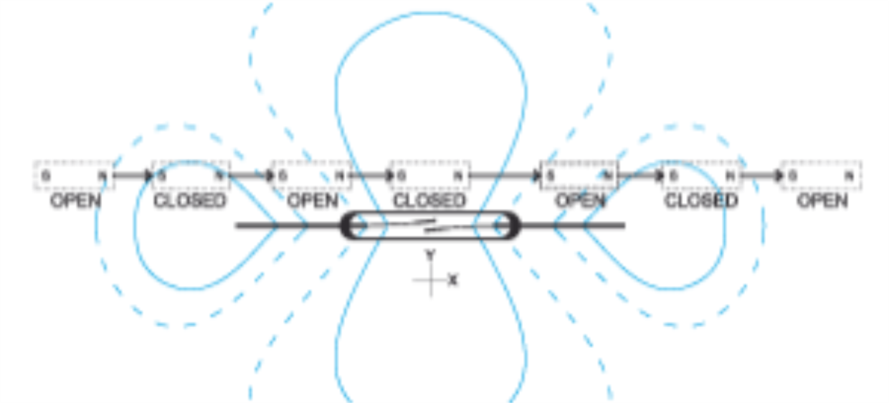
Reed Switch for counting pulses
A reed switch is a simple device that allows a circuit to be completed by passing a magnet close to it.
With a magnet at the end of the motor shaft, pulses can be counted for every half cycle of the shaft.
This will keep the program updated as far as the dish’s location

Slide 9
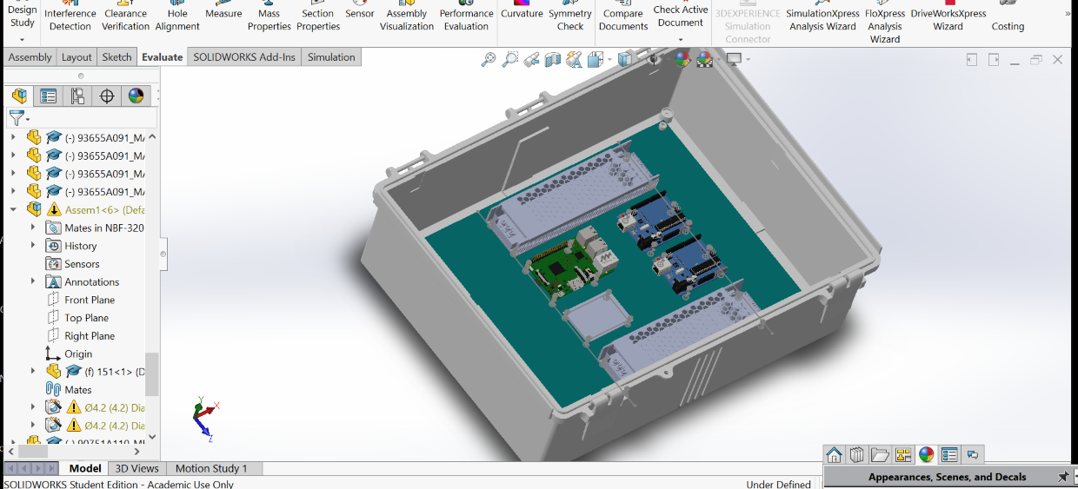
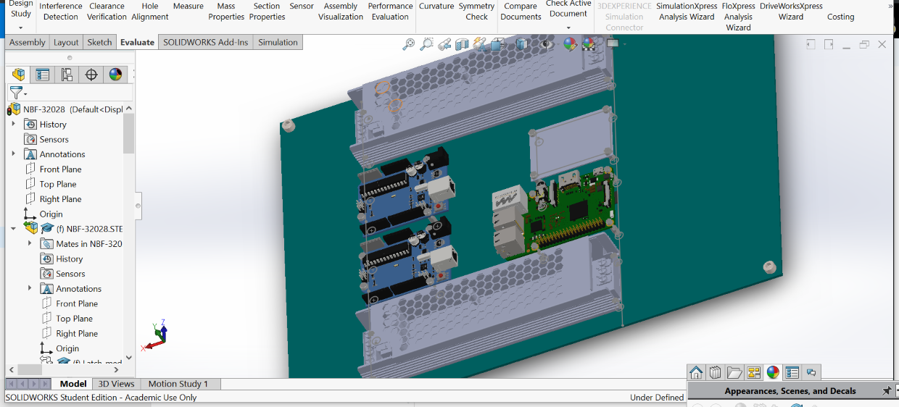
Solidworks for box layout
SOLIDWORKS is being used to model the layout of the enclosure that will house the electronics from the weather.
A Raspberry Pi will be implemented for the high-level thinking and running the Graphical User Interface (GUI).
The Pi communicates with two Arduinos via serial connection that, in turn, send commands to the Pololu, count pulses and check limit switches.

Slide 10
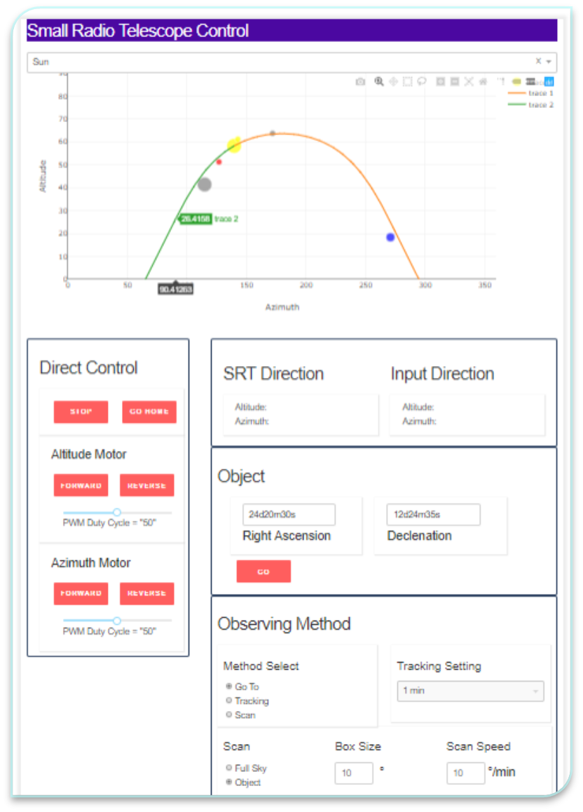
GUI
Reports the location of major bodies in this solar system.
Tracks trajectory of an object of the users choice.
Can also track an object based on input Right Ascension and Declinenation.
Direct Controls work and have been implemented, Observing Methods have not.
This took about 1000 lines of code.

Slide 11
Thanks again
To Dr. Carl Ferkinhoff
To Dr. Nathan Moore
To Luke Zwiefelhofer
To Rochester High School

